Slide 1
Unleash hardware's full potential with smart system tuning for SAP workloads
Howard Guo
Senior Software Developer
hguo@suse.com

Slide 2
Getting ready for SAP
Install operating system
Tune performance
Install SAP software
Evaluate

Slide 3
Challenges
  SAP tuning guides only written for individual software solutions.
  Lengthy tuning guides take considerable effort to implement.
  Combining tuning guides from various solutions is error prone.
  Lacking manageability in ongoing system maintenance.

Slide 4
Legacy method - “sapconf”
  Available in all editions of SUSE Linux Enterprise 11 and 12.
  Using a checklist approach, profiles are provided for popular solutions:
    SAP Netweaver
    SAP HANA
    SAP ASE and BusinessObjects
  Only one profile may be activated at a time.
  No way to verify system state in ongoing maintenance.

Slide 5
Introducing saptune - comprehensive tuning management

Slide 6
New utility - saptune
  Available in SUSE Linux Enterprise For SAP since 12 SP2.
  Tune for individual and combination of SAP solutions.
  Conduct simulation run to determine how system will be changed.
  Verify system state for ongoing maintenance.
  Reverse tuning actions on-demand.
  Capable of operating in virtualised environments such as public and private cloud.
Link: project source code https://github.com/HouzuoGuo/saptune

Slide 7
Workflow
Simulate
Apply
Verify

Slide 8
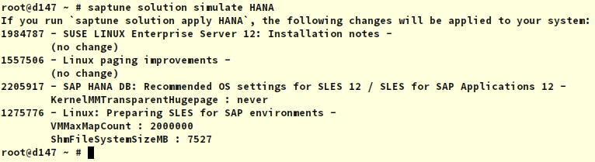
Step 1 – simulate
  Choose solutions (e.g. Netweaver/HANA) to tune for.
  Run “saptune simulate solution”.
  Evaluate before/after values:

Slide 9
Workflow
Simulate
Apply
Verify

Slide 10

Step 2 – apply
  Conduct system tuning prior to installing SAP software.
  Apply tuning options for all applicable SAP solutions:

Slide 11
Workflow
Simulate
Apply
Verify

Slide 12
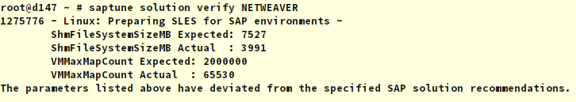
Step 3 – verify
  Ensure current configuration does not deviated from optimal setting.
  Conduct verification periodically in ongoing maintenance.

Slide 13
Rationale in tuning for SAP softwares

Slide 14
Common technique in tuning kernel resources
  As much as possible, loosen restrictions on:
    Shared memory capacity
    Semaphore capacity
    Number of memory map areas
  Disable computation-intensive memory management features:
    Automated NUMA-balancing
    Same page merging
    Transparent huge pages

Slide 15
Common technique in tuning page cache
  Tell kernel to avoid moving application memory into swap.
  Ensure consistent application response time.
  Calculate “vm.pagecache_limit_mb”:
    Different SAP solutions suggest
    Automatically tuned by both sapconf and saptune.

Slide 16
Situational techniques
  Decrease swap usage.
  Allow over committing memory usage.
  Experiment with alternative IO schedulers.
  Tweak file system parameters according to storage capability.
  Adjust VFS cache behaviour in preparation for memory pressure.
  Make IO read-ahead more aggressive.

Slide 17
More situational techniques
  Increase buffer and backlog capacity in network stack.
  Disable advanced computation-intensive TCP features.
  Bind processes to specific number of CPUs.
Link: OS tuning and optimisation guide
https://www.suse.com/communities/blog/sles-1112-os-tuning-optimisation-guide-part-1/

Slide 18
Bonus topic – data-at-rest encryption

Slide 19
Challenges
  Each encrypted disk should use a unique key instead of a common password.
  Central management of encryption keys is a difficult administrative challenge.
  Encryption mechanism should be transparent to applications.

Slide 20
Introducing cryptctl -
KMIP-capable disk encryption management

Slide 21
Introducing cryptctl
  Available in SUSE Linux Enterprise For SAP since 12 SP2.
  Install unique key to encrypted partitions.
  Track and monitor key usage.
  Transparent to applications, tailored for SAP workload.
  Integrates with key management appliances via KMIP – Key Management Interoperability Protocol.
  Use a KMIP-compatible appliance to centrally manage all types of keys and secrets, including disk encryption keys.
Link: project source code https://github.com/HouzuoGuo/cryptctl

Slide 22
Workflow
Initialise server
Encrypt directory
Ongoing maintenance

Slide 23
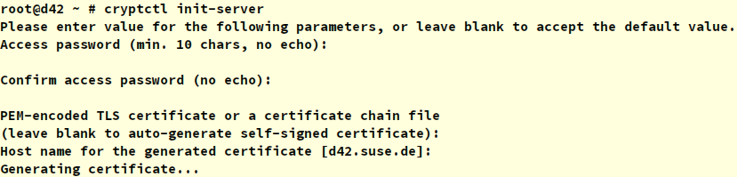
Initialise server
  Specify master password and set up TLS certificate.
  Optionally:
    Enable client certificate verification.
    Connect to a KMIP appliance.
    Set up Email notification.

Slide 24
Workflow
Initialise server
Encrypt directory
Ongoing maintenance

Slide 25
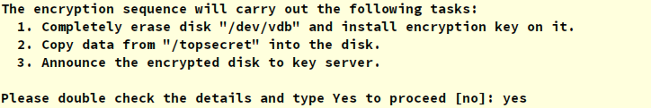
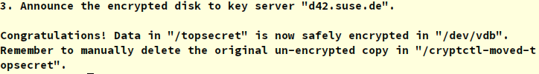
Encrypt directory
  Set up transparent encryption using Linux Unified Key Setup.
  Use randomly generated key and safe keep it in database.
  Encrypted directories are automatically opened upon reboot.
… and success!

Slide 26
Workflow
Initialise server
Encrypt directory
Ongoing maintenance

Slide 27
Ongoing maintenance
  Alter mount point directory and mount options.
  Issue commands from key server to open and close encrypted directories on specific client computer.
  Revoke encryption key – effectively erasing encrypted data.

Slide 28
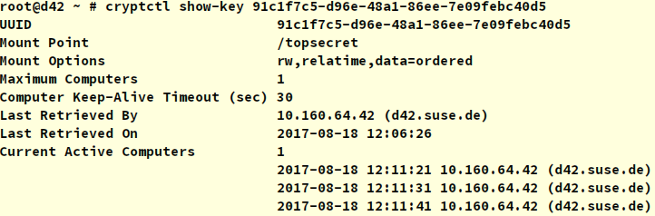
Ongoing maintenance
Audit key usage - timestamp, computer IP, and many other details are recorded along with disk unlocking attempts.

Slide 29
Open Discussion

